Slide 1
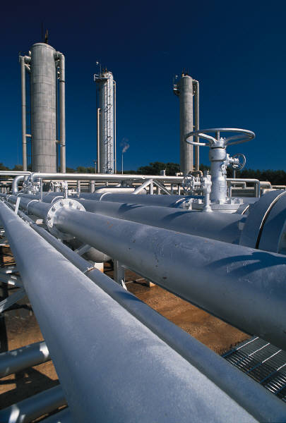
An Overview of the Natural Gas System

Slide 2
What is natural gas?
Natural gas is composed of hydrocarbons (combinations of hydrogen and carbon).
89 - 93 % methane gas, the lightest hydrocarbon
Plus other gases such as ethane, propane, butane, and non-flammable gases such as nitrogen and carbon dioxide.

Slide 3
Properties of Natural Gas
Natural gas has narrow combustion limits. This helps ensure predictable, safe use.
Natural gas will only ignite when there is an air-and-gas mixture of between 5 and 15 percent natural gas.
Any mixture containing less than 5 percent or greater than 15 percent natural gas will not ignite.

Slide 4
Properties of Natural Gas
When taken from the ground, natural gas is odorless. A harmless but pungent odorizor, mercaptan, is added as a safety precaution. The odorant is so powerful you can smell even the smallest quantity of gas in the event of a leak.

Slide 5
If you smell mercaptan…
Do not attempt to locate gas leaks.
Leave the building when there is a strong gas odor.
Do not turn on or off any battery-powered, rechargeable or electrical device, including phones, garage door opener, radios, TVs, computers or any device that could create a spark.
Do not turn on or turn off any lights or electrical switches, or unplug appliances.

Slide 6
If you smell mercaptan…
Do not use telephones of any type in the building.
Do not use elevators.
Do not position or operate vehicles and power equipment where leaking gas may be present.
Do not smoke or use lighters, matches or other open flames.
From a safe distance from the building, call your gas company’s emergency line. If they do not answer, call 911.

Slide 7
Natural gas use in the U.S.
Natural gas comprises approximately 24% of our national fuel supply; of that,
34% is used commercially and in residences
34% is used industrially
29% is used to generate electricity
3% is used for transportation
U.S. Primary Energy Consumption by Source and Sector, USDOE, 2009

Slide 8
Units of measurement
Cubic foot – measure of volume of gas
CCF – 100 cubic feet
BCF – 1 billion cubic feet
BTU – measure of heat energy; 1 cubic foot of gas yields about 1000 BTUs
Therm – often used as the standard unit of billing in the U.S.; equal to 100,000 BTUs
Dekatherm – 10 therms; 1 million decatherms = 1 billion cubic feet of gas

Slide 9
Stop and think…
What factors determine whether a consumer uses natural gas in the home and how much they consume?
Geographic region affects:
availability of resource
climate (seasonal temperatures)
Construction trends
Price
Energy efficient appliances

Slide 10
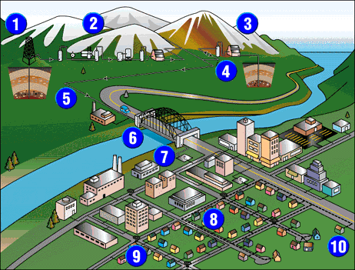
How does it get to the consumer?
Exploration of potential gas fields and extraction from gas wells
Gas cleaning and treatment to remove sand and hydrogen sulfide and valuable products such as light oils, natural gasoline, butane, ethane and propane

Slide 11
How does it get to the consumer?
Compressor station increases gas pressure before feeding it into a high pressure transmission pipeline; OR
Gas storage field

Slide 12
Gas Storage
Stored underground, often in old oil fields, salt domes, or porous rock surrounded by solid rock
Gas is injected into storage sites during off-peak season when demand is lower (summer)
Gas is withdrawn during peak demand seasons (winter)

Slide 13
Compressor Stations
Transmission lines lose pressure due to flowing friction in the lines
Compressor stations every 50 to 100 miles boost pressure
Pressure is measured in pounds per square inch (psi)

Slide 14
What are two benefits of compression?
Reduces size of natural gas molecules—increases amount of natural gas that can be moved through a pipeline
Provides propellant force to move natural gas through the pipeline system

Slide 15
How does it get to the consumer?
High pressure transmission lines, both interstate and intrastate
Suspended transmission lines to avoid obstacles
Regulators which reduce pressure before feeding gas into distribution mains

Slide 16
Protecting the Pipelines
Pressure Limiting Stations (PLS) – limit maximum pressure
Line Rupture Control Valves – isolate major leaks
SCADA

Slide 17
How does it get to the consumer?
Distribution lines carry gas from the transmission system to the customer
High‑pressure mains - 60 psi (pounds per square inch)
Semi-high pressure mains – 25 psi
Low‑pressure mains – less than 1 psi

Slide 18
How does it get to the consumer?
High and low pressure distribution mains, which lead to city gate stations and the local distribution system
Valves, which can shut off street mains leading to service connections
Service connections, which provide gas to individual homes or businesses

Slide 19
Distribution System Components
Valves - isolate during construction and emergencies
Gas Services connect the distribution mains to the customer

Slide 20
Distribution System Components
Shut‑off valves located at the customer meter and can shut off gas to a house in an emergency
For gas coming from high-pressure mains, a service regulator located at the meter reduces the pressure to the standard .25 psi for safe home use

Slide 21
Gas System History
A small gas well was dug in 1821 but gas was used mainly for lighting and then replaced by electricity
A 120 mile pipeline from Indiana to Chicago was built in 1891
Major pipeline construction began in the 1920s
Metallurgical advances following WWII meant that the U.S. had the technology to build an extensive network; a pipeline construction boom resulted

Slide 22
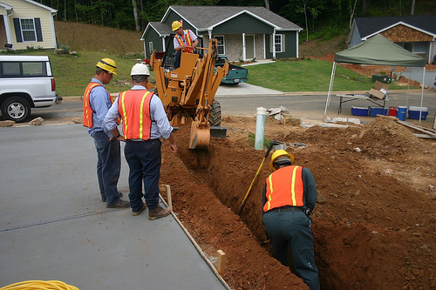
Gas System Tools
Digging has been a big part of the pipeline construction and maintenance process since the beginning
Some tools are common to all parts of the gas system

Slide 23
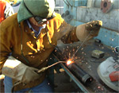
Gas System Tools
Welding is a common task
Welding uses a unique group of tools and equipment

Slide 24
Gas System Tools
Many tools differ for each part of the gas system
Tools can also differ for each job in each part of the system
Gas Measuring Instrument
Long-Handled Pipe Squeezers

Slide 25
Tools Used to Search for Gas Leaks
The Optical Methane Detector (OMD) light bar is mounted on the front of a survey vehicle. The light bar utilizes an infrared light directed at an infrared optical detector and measures methane gas in parts per million.

Slide 26
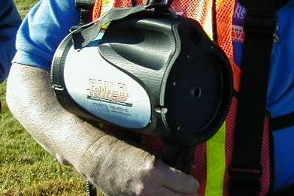
Tools Used to Search for Gas Leaks
Remote Methane Leak Detector (RMLD)
The presence of methane is encoded within the returned light (methane is the largest component of natural gas). Methane readings are displayed in parts per million.

Slide 27
Gas Utility Safety Pledge
From Pacific Gas & Electric, but similar philosophies are seen at every utility company:
I always put safety first.
I look for and act to resolve unsafe situations.
I help and encourage others to act safely.

Slide 28
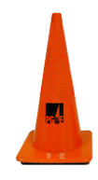
Gas Utility Safety
Utility companies’ safety policies strive for:
Zero workplace accidents
Continuous practice and policy review for reduced accidents
Enhanced compliance with safety regulations and company policies

Slide 29
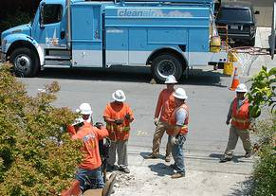
Gas Utility Safety
Worker Safety
Customer Safety
Equipment Safety

Slide 30
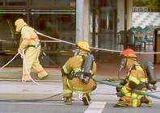
Worker Safety
Personal Protective Equipment – hard hat, safety vests, fire resistant flash suit, etc.
Safe work practices and procedures
Extensive safety training
Safety focused workers and management

Slide 31
Customer Safety
Emergency preparedness
Fire safety
Flood safety
Fire and law enforcement first responder coordination

Slide 32
Customer Safety
Underground Service Alerts
Customer safety planning

Slide 33
Equipment Safety
Gas valves and other gas storage and distribution equipment are engineered with safe operation and equipment value conservation in mind

Slide 34
For more information…
The Interstate Natural Gas Association of America http://www.ingaa.org/
Independent natural gas site http://natgas.info
U.S. Department of Transportation, Pipeline and Hazardous Substance Transportation Administration http://phmsa.dot.gov/pipeline
National Pipeline Mapping System http://www.npms.phmsa.dot.gov/

